Slide 1


SAP S/4HANA CDS, RAP Training Day 4
Anubhav Oberoy

Slide 2

Agenda – Day 4
Optimization for SQL Script in AMDP
CDS Table function
CDS hierarchy
--break
Currency Conversion and SAP Analytics Cloud
Cloud Connector
Connect BAS with S/4HANA
--break
Understand OVP Fiori App
Use case to implement OVP
Notes:
https://unsplash.com/photos/CPs2X8JYmS8

Slide 3

Optimization for SQL Script in AMDP
--Q1
lt_products = select prod_id from products WHERE type = ‘WebCAM’;
--Q2
lt_so = select * from sales WHERE pid in ( select prod_id from lt_products );
--Q3
lt_po = select * from pruc WHERE pid in ( select prod_id from lt_products );
--Q4
lt_so = select sum(amount), comp_code from lt_so;
When will hana come out of parallel mode
Whenever a DDL/DML statement is executed
Whenever the result is not assigned to implicit table
Any declare statement is detected
Any imperative logic like loop, if etc.
Rules:
Write all DML/DDL/Processing logic at the end of all code.
Split code in different AMDP.
9
www.anubhavtrainings.com

Slide 4
CDS Table function
Is a new feature introduced in SAP NW 7.5 onwards to enrich the CDS concept. It allows following
We can integrate SQL script code with CDS views
We can overcome the limitations and disadvantages of cds views
We can call an AMDP using CDS
Helps to eliminate the type conflict issues with cds
Allows to integrate the complex logic with cds views
We can reuse the cds table function in another cds view with associations and joins
A cds table function is just like AMDP which can be used to integrate the SQL Script logic. But behind the scenes it will create a Table UDF in HANA. A CDS table function
Will contain a CDS definition, which will act like skeleton of the output data
But eventually it will invoke a class function which contains SQL script code
This SQL script code can call AMDP, pure SQL script logic
Use Case
Once upon a time in Mumbai, I was working on a project there was a requirement to convert an ABAP report to CDS view. This report was joining but000 (customer master) table with crmd_partner (crm partners)
9
www.anubhavtrainings.com

Slide 5
Hierarchy
A hierarchy is a tree data-structure. A tree is composed of nodes. These nodes can be root node (top most), parent node, and child node. A hierarchy in ERP represent our business data as a TREE data structure.
Why?
It is a better representation of data in form of nodes
We can easily identify the relationship between data
It is also useful for visualization
Easy to traverse the data
ERP is full of hierarchy
Employee-manager hierarchy
Org structure
Cost Centre hierarchy
Profit Centre Hierarchy
There are 2 ways to build hierarchy in CDS views
New Hierarchy
Classic hierarchy
9
www.anubhavtrainings.com

Slide 6


































































Slide 7

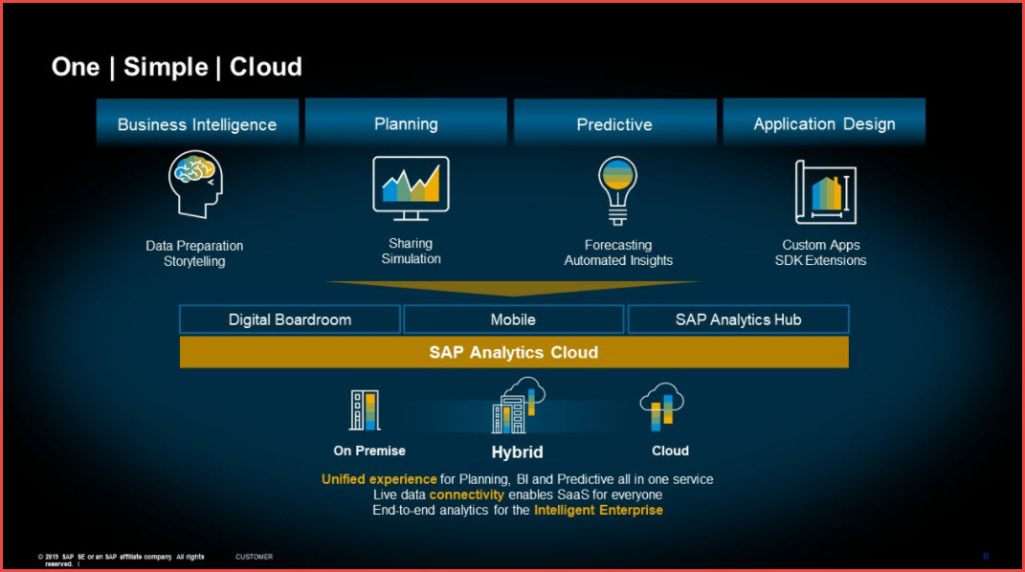
SAP Analytics Cloud
SAP Analytics Cloud brings together analytics and planning in a single solution in the cloud. You can instantly move from insight to action, simulate any scenario for better business outcomes, and generate plans from predictions automatically to drive agile decisions.

Slide 8

Basics of Connectivity and Role of SCC
Internet
Intranet
SAP BW
SAP ECC
SAP S/4 Hana
SAP BTP (PublicCloud)
SAP Cloud Connector
SAP On-premise System
SAP Business Application Studio
SCC
Destination
S/4 Hana Cloud
Field Glass
Sales Force

Slide 9
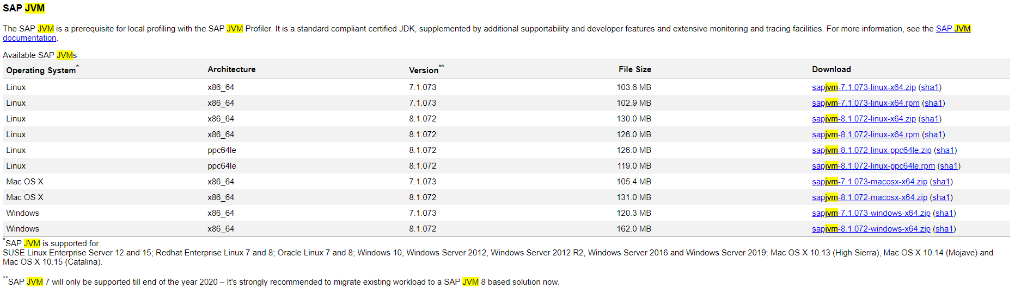
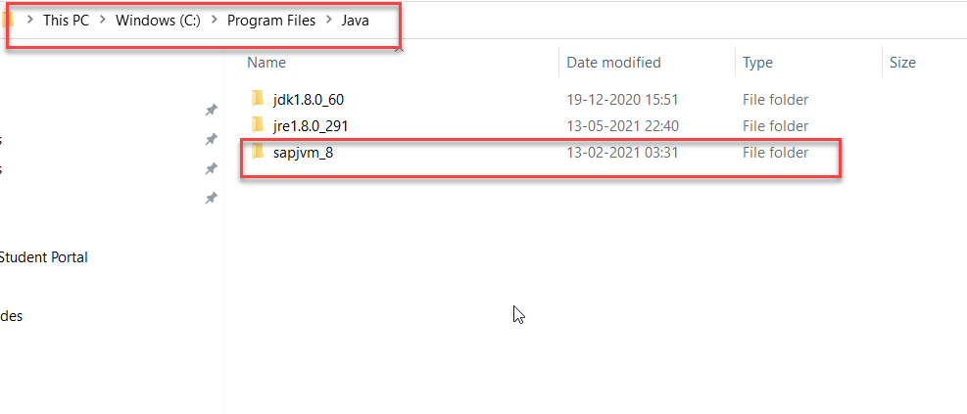
Cloud Connector
Step 1: Download SAP JVM and Extract it in the C:\Program Files\Java

Slide 10
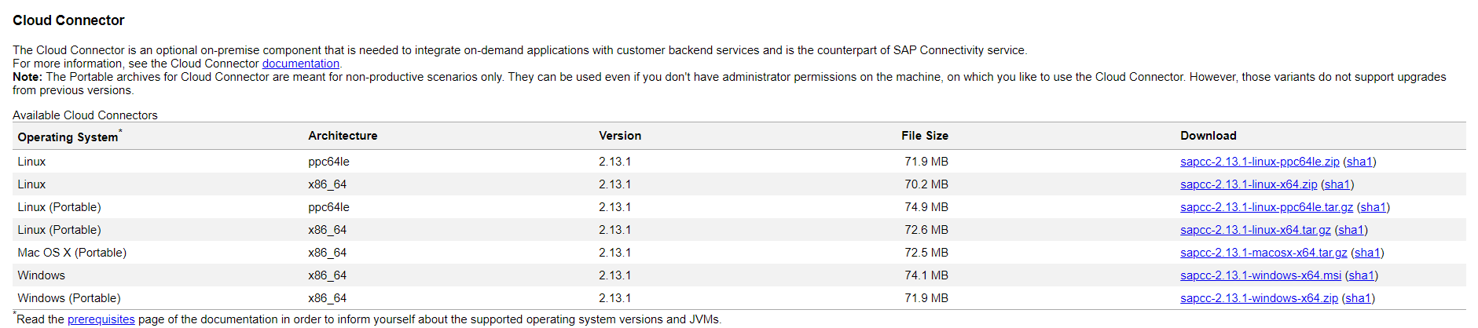
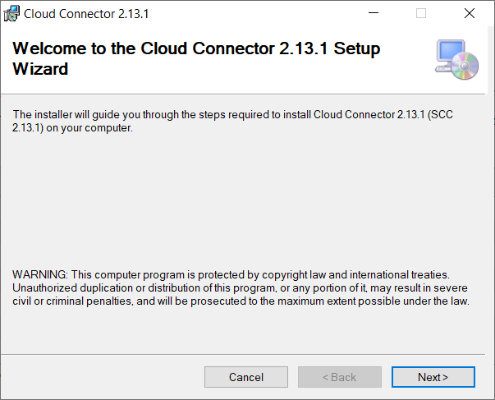
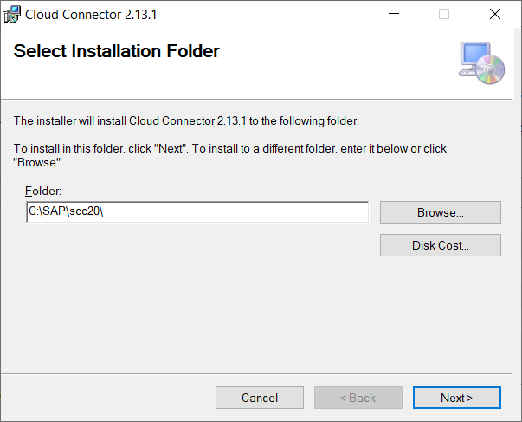
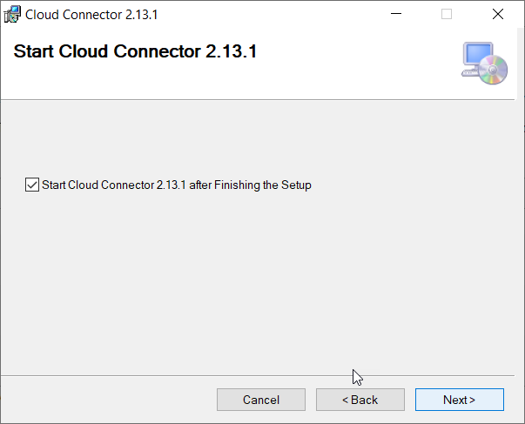
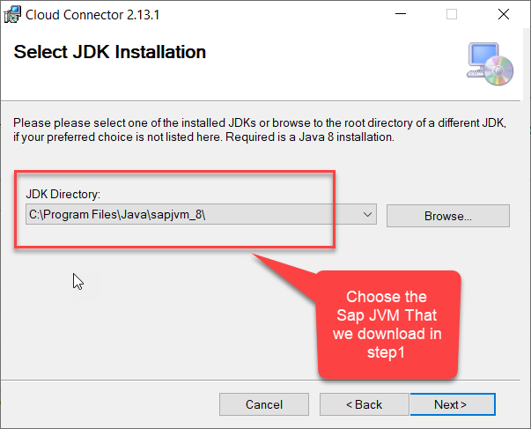
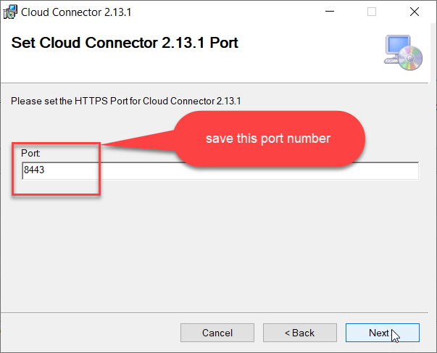
Cloud connector continue…
Step 2: Download and install the sap Cloud connector

Slide 11
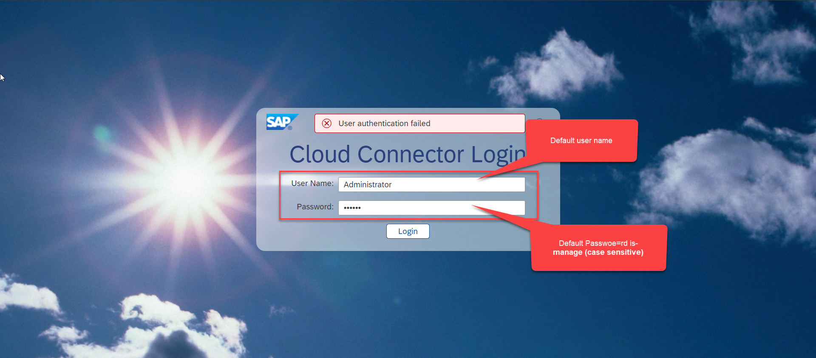
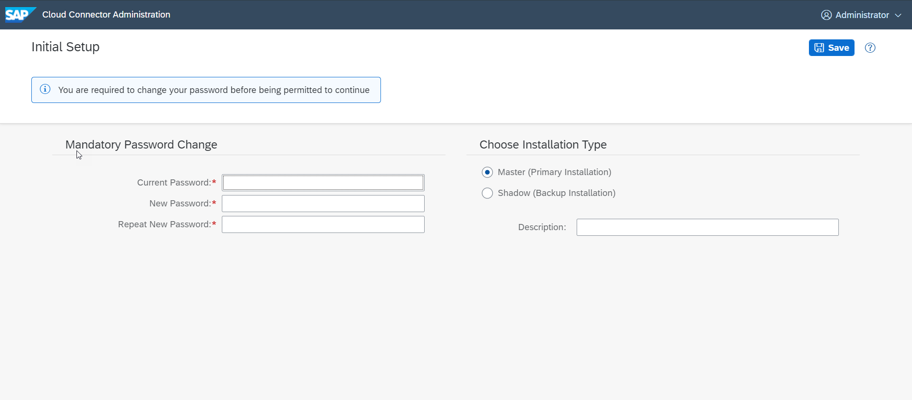
Cloud connector continue…
Step 3: Now your system is ready go to browser and open https://localhost:8443 (port may changes)
The default credentials are Administrator / manage

Slide 12
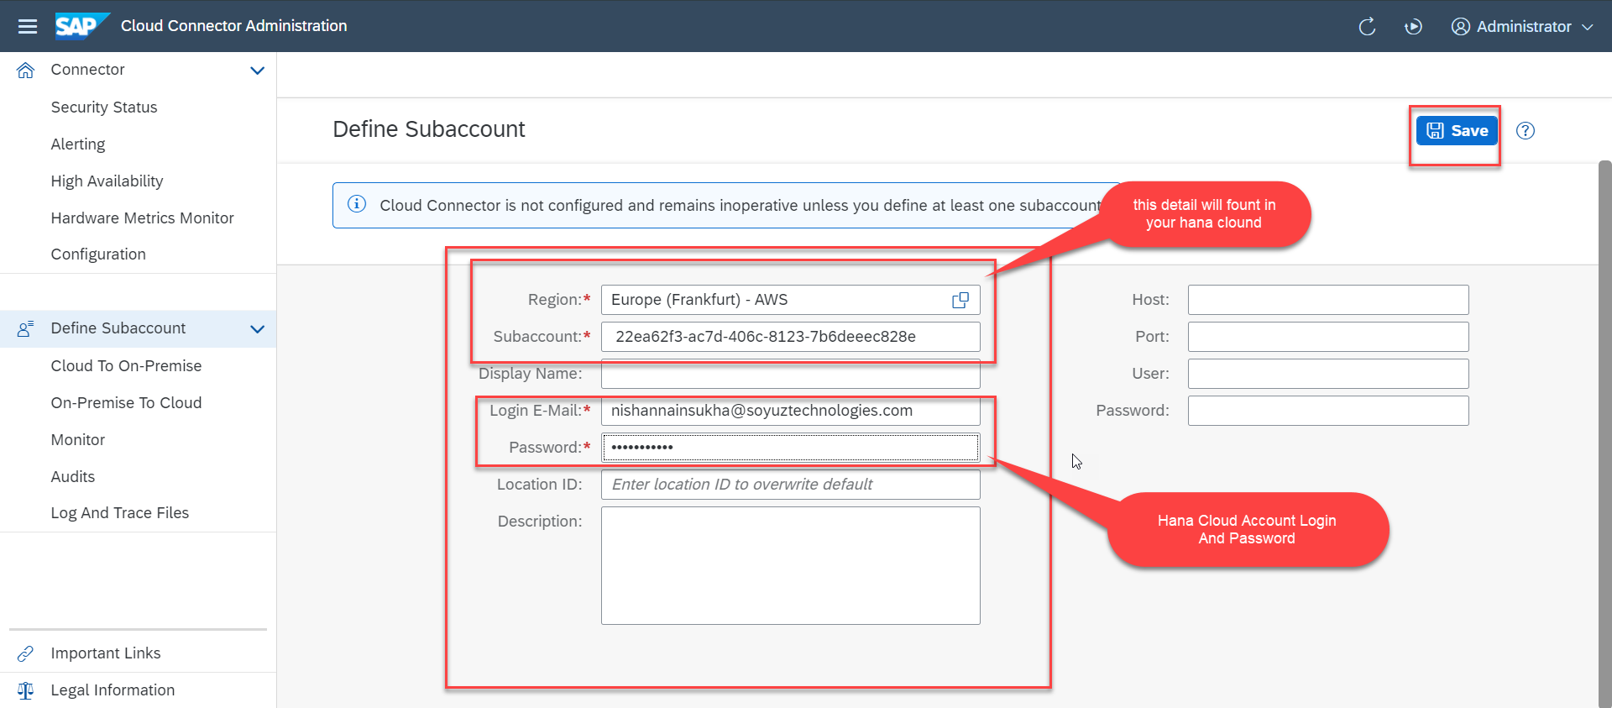
Cloud connector continue…
Step 4: Now we create a connection with our Cloud Account

Slide 13
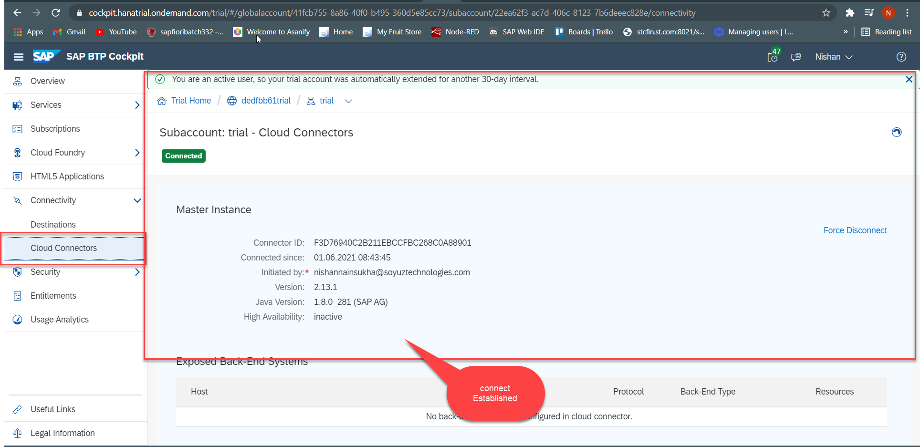
Cloud connector continue…
Step 5: Check the connection on Hana Cloud Account

Slide 14
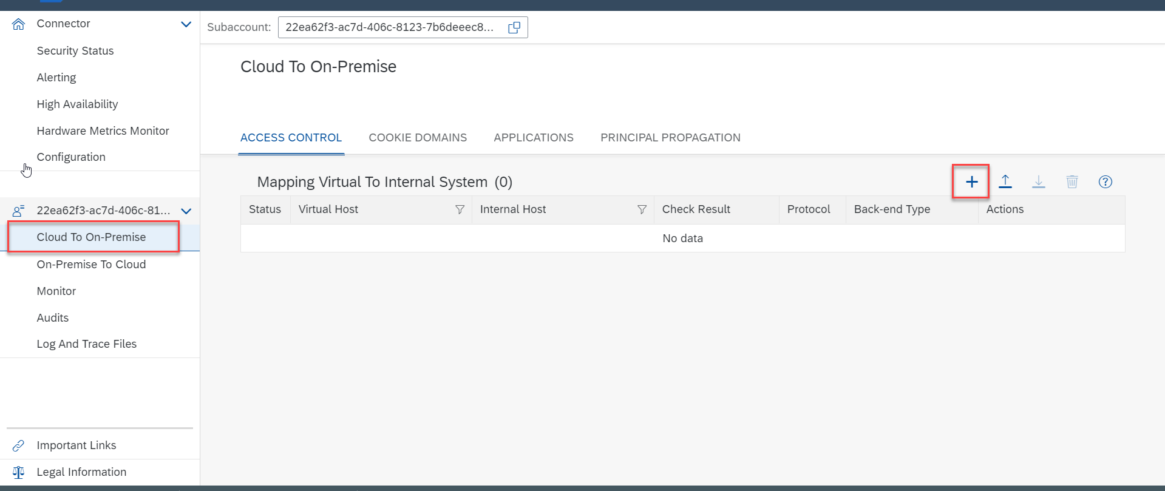
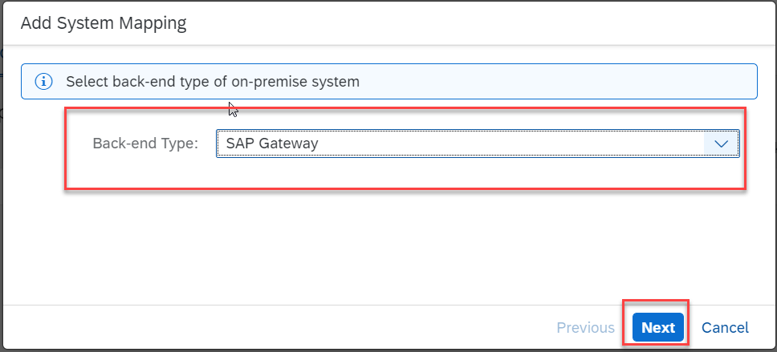
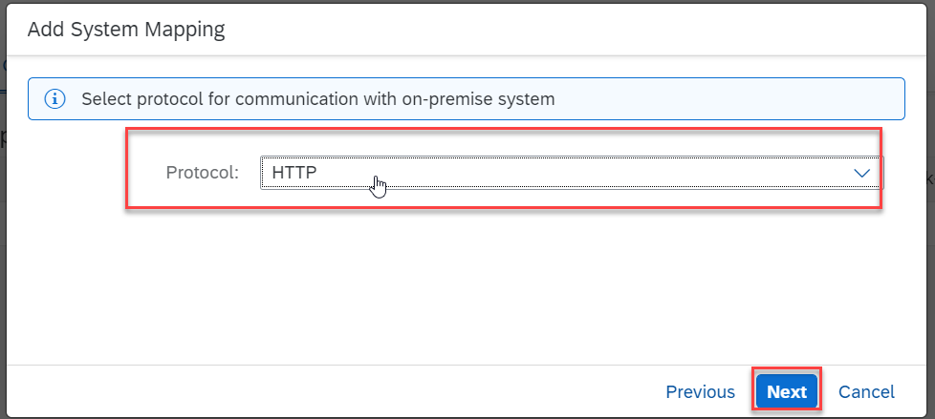
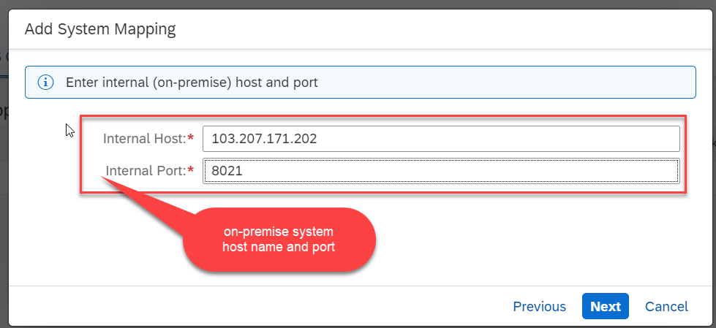
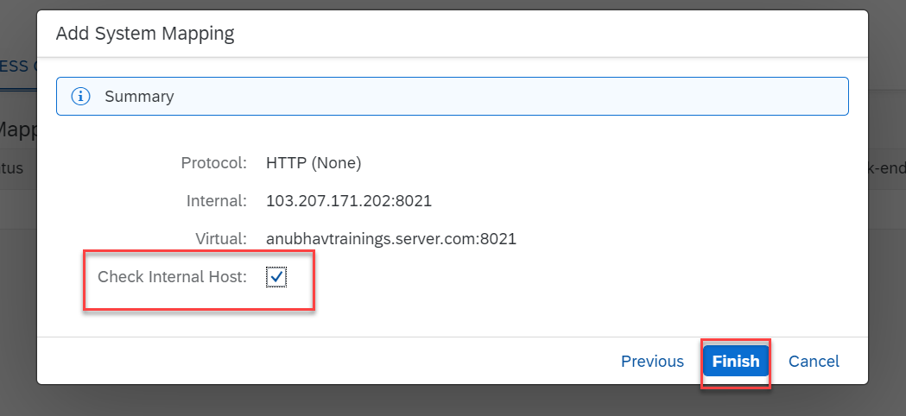
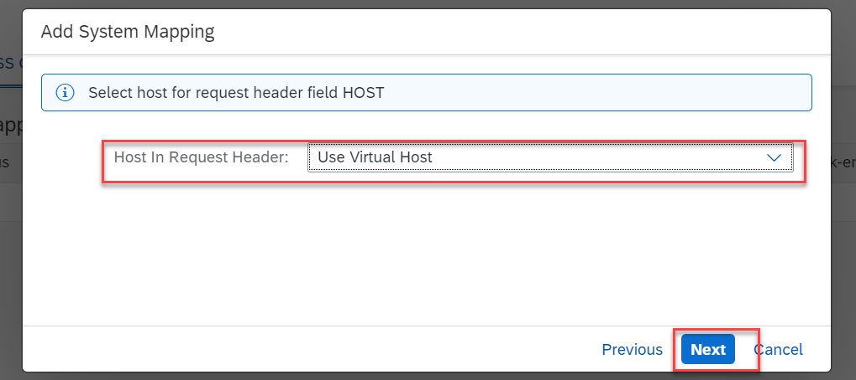
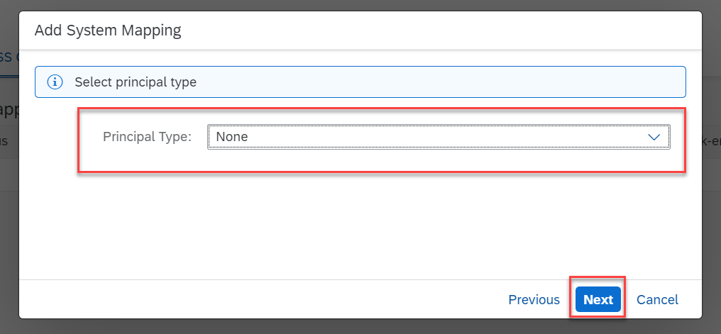
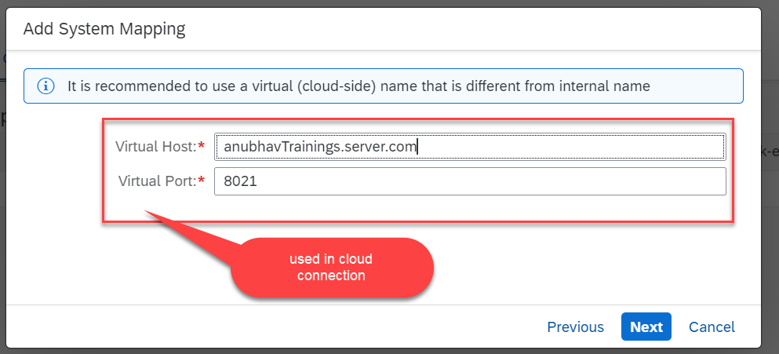
Cloud connector continue…
Step 6: Connect on-premise system to cloud using SCC

Slide 15
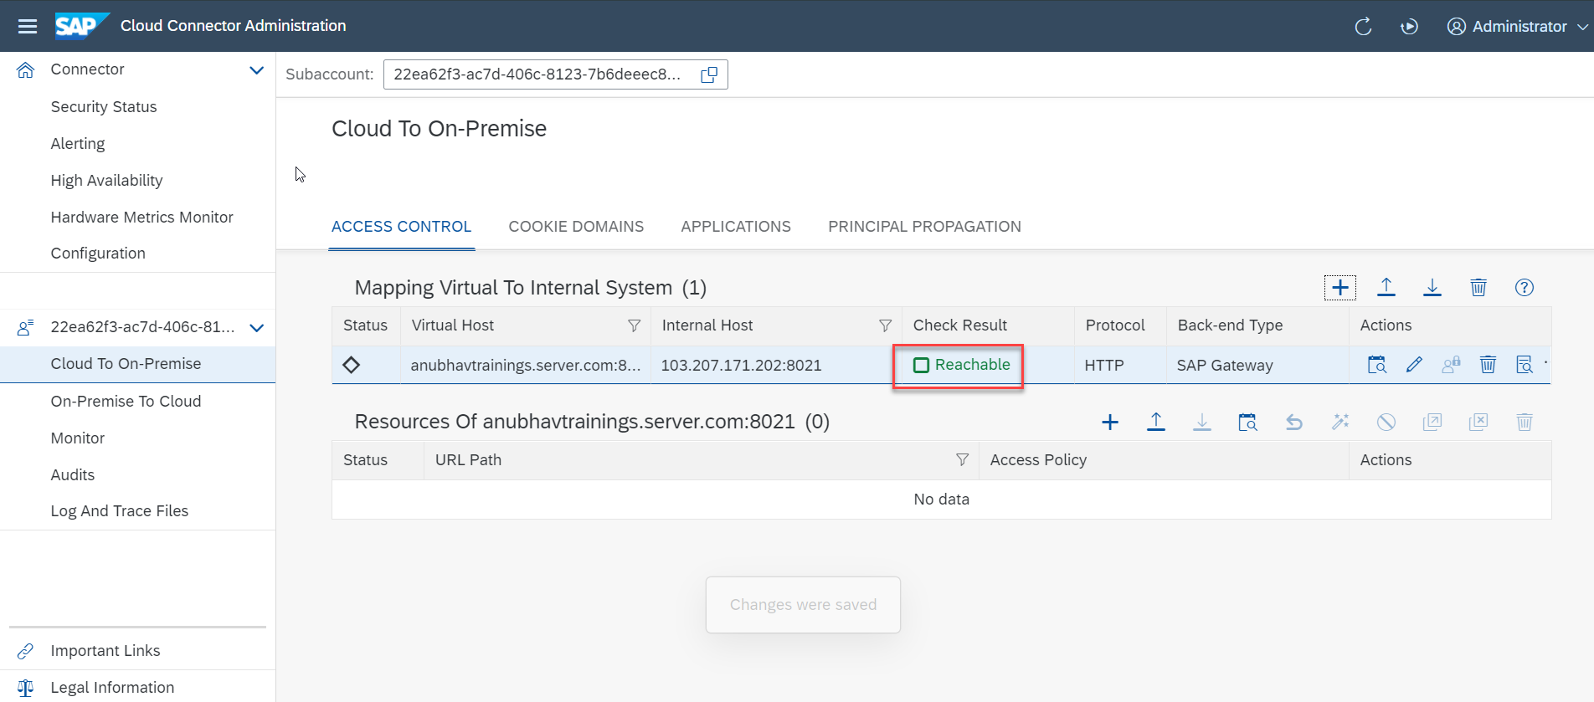
Cloud connector completed
We have Done with Connect , now we are now successfully connected to cloud using SCC.

Slide 16
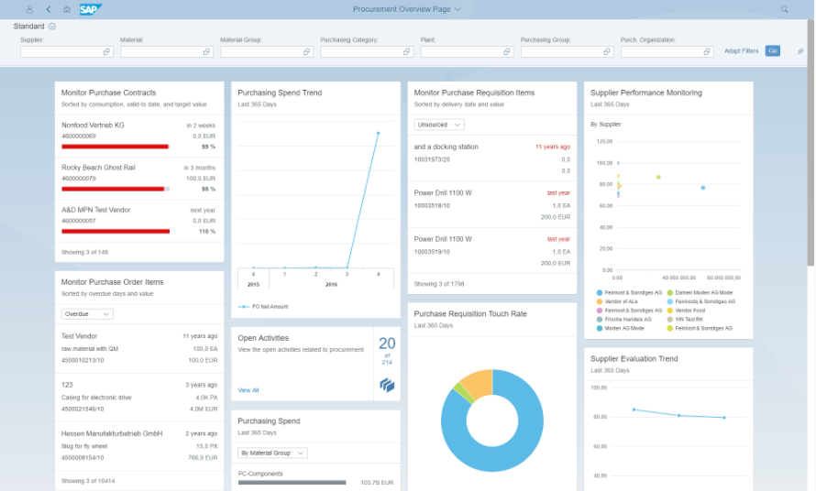
OVP Applications in S/4HANA
The overview page (OVP) is a data-driven SAP Fiori app type and floorplan that provides all the information a user needs in a single page, based on the user's specific domain or role.

Slide 17





































Title
Text

Slide 18
Title
Text

Slide 19
Title
Text

Slide 20

Questions?

Slide 21

Thank you
Anubhav.abap@gmail.com
contact@anubhavtrainings.com
+91 84484 54549
www.anubhavtrainings.com

